Slide 1
PEP classes

Slide 2
Problem1: Leetcode Task
https://leetcode.com/problems/k-diff-pairs-in-an-array/description
Start time:
Time allowed: 10-20 min

Slide 3
SOLUTION K DIFF PAIR
class Solution {
public:
int findPairs(vector<int>& nums, int k) {
int n = nums.size();
// Sort the array to simplify pair checking
sort(nums.begin(), nums.end());
int cnt = 0;
// generate all possible pairs
for (int i = 0; i < n; i++) {
// Skip duplicate a values
if (i > 0 && nums[i] == nums[i - 1])
continue;
for (int j = i + 1; j < n; j++) {
// If absolute difference = k, then increment
// count by 1
if (abs(nums[i] - nums[j]) == k) {
cnt += 1;
}
}
}
return cnt;
}
};

Slide 4
Two Sum - Pair sum in an array
Given a sorted array arr (sorted in ascending order) and a target, find if there exists any pair of elements (arr[i], arr[j]) such that their sum is equal to the target.
Illustration :
Input: arr[] = {10, 20, 35, 50}, target =70
Output: Yes
Explanation : There is a pair (20, 50) with given target.
Input: arr[] = {10, 20, 30}, target =70
Output : No
Explanation : There is no pair with sum 70
Input: arr[] = {-8, 1, 4, 6, 10, 45], target = 16
Output: Yes
Explanation : There is a pair (6, 10) with given target.
Source:
https://www.geeksforgeeks.org/dsa/two-pointers-technique

Slide 5
Problem leetcode 2
https://leetcode.com/problems/two-sum

Slide 6
Approach1: brute force
To search for all possible pairs of numbers.
It would be too slow.
Best to try out brute force solutions for just for completeness.
You can come up with optimizations.
class Solution {
public:
vector<int> twoSum(vector<int>& nums, int target) {
int f,s;
for (int i=0;i<nums.size()-1;i++)
for (int j=i+1;j<nums.size();j++)
{
if(nums[i]+nums[j]==target) { f=i;s=j;}
}
return {f,s};
}
};

Slide 7

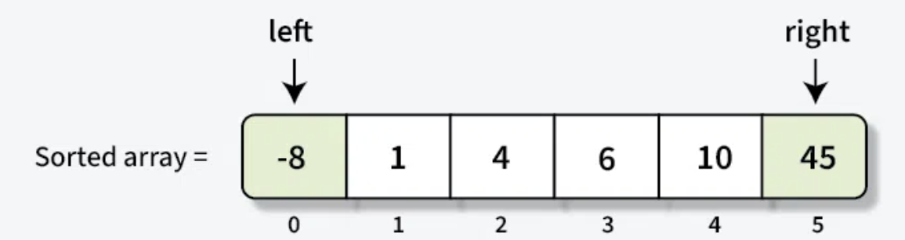
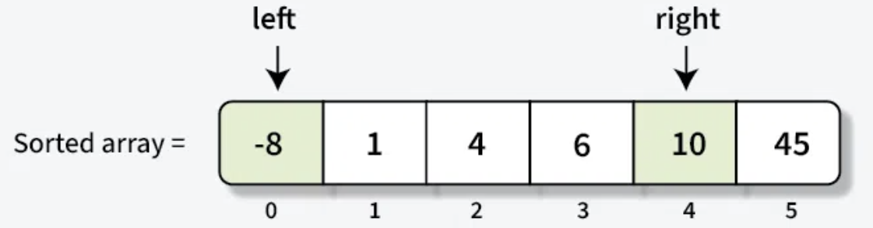
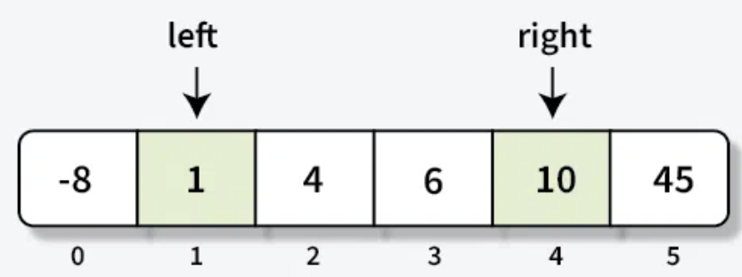
Approach 2: two-pointer technique
When the input array is sorted.
Pointers at the start and another at the end.
Calculate the sum of the elements at these pointers.
If the sum equals the target → you've found your answer.
If the sum is less than the target → move the left pointer forward to increase the sum.
If the sum is greater than the target → move the right pointer backward to decrease the sum.
Repeat until the pointers meet or you find the target sum.
O(n), assuming the array is sorted.

Slide 8
STL vector sort
The time complexity vector in C is O(N log N).
Typically employs Introsort (hybrid sorting algorithm)
combining the strengths of QuickSort, HeapSort, and Insertion Sort:
This hybrid approach ensures optimal performance across various data distributions.
std::vector<int> myVector = {5, 2, 8, 1, 9};
std::sort(myVector.begin(), myVector.end()); // 1. Basic ascending sort
// 2. Descending sort using std::greater<>
std::sort(myVector.begin(), myVector.end(), std::greater<int>());

Slide 9
Wrong approach of “sorting”
class Solution {
public:
vector<int> twoSum(vector<int>& nums, int target) {
sort(nums.begin(),nums.end());
int left = 0;
int right = nums.size() - 1;
while (left < right) {
int sum = nums[left] + nums[right];
if (sum == target) { return {left, right}; } // indices of the result
else if (sum < target) {left++; } // increase sum
else { right--; } // decrease sum
}
return {}; // If no solution found
}
};
🧠 Why Sorted Indices Break the Return
After sorting nums, the indices {left, right} no longer point to the original positions of those values—just their positions in the sorted array.

Slide 10
Correct approach
class Solution {
public:
vector<int> twoSum(vector<int>& nums, int target) {
// Step 1: Create auxiliary vector with value and original index
vector<pair<int, int>> aux;
for (int i = 0; i < nums.size(); i++) {
aux.push_back({nums[i], i});
}
// Step 2: Sort the auxiliary vector by values
sort(aux.begin(), aux.end());
// Step 3: Apply two-pointer logic
int left = 0, right = nums.size() - 1;
while (left < right) {
int sum = aux[left].first + aux[right].first;
if (sum == target) {
// Return the original indices from the aux vector
return {aux[left].second, aux[right].second};
} else if (sum < target) {
left++;
} else {
right--;
}
}
return {}; // If no pair found
}
};

Slide 11
Approach 3 using hashmap
Unordered_map is an unordered associative container.
It stores data in the form of unique key-value pairs.
But unlike map, unordered map stores its elements using hashing.
Average constant-time complexity O(1) for search, insert, and delete.
The elements are not sorted in any particular order.

Slide 12
// Create an empty unordered_map
unordered_map<int, string> um1;
// Creating an unordered_map using
// initializer list
unordered_map<int, string> um2 = {{1, “Hello"}, {2, “to"}, {3, "C++"}};

Slide 13
🧠 Core Idea
Use an unordered_map as a fast lookup table to store each number we’ve seen along with its index.
As we iterate through the array:
For each element x, we check if target - x already exists in the map.
  If yes ➝ we found the complement earlier and can return the pair of indices.
  If no ➝ store x and its index in the map to check for future matches.
This leverages constant-time average lookups (O(1) time complexity) using hashing.

Slide 14
🔹 Step 1:
i = 0, nums[0] = 20
Complement: 9 - 20 = -11
Is -11 in seen? ❌ No
Save: seen[20] = 0 → seen = {20: 0}
🔹 Step 2:
i = 1, nums[1] = 7
Complement: 9 - 7 = 2
Is 2 in seen? ❌ No
Save: seen[7] = 1 → seen = {20: 0, 7: 1}
🔹 Step 3:
i = 2, nums[2] = 11
Complement: 9 - 11 = -2
Is -2 in seen? ❌ No
Save: seen[11] = 2 → seen = {20: 0, 7: 1, 11: 2}
🔹 Step 4:
i = 3, nums[3] = 2
Complement: 9 - 2 = 7
Is 7 in seen? ✅ Yes → found at index 1 ✅ Return: {1, 3}
nums = [20, 7, 11, 2, 15]
target = 9

Slide 15
Approach 3: Hashmap/ ordered map
class Solution {
public:
vector<int> twoSum(vector<int>& nums, int target) {
unordered_map<int, int> seen;
for (int i = 0; i < nums.size(); i++) {
int complement = target - nums[i];
if (seen.count(complement)) {
return {seen[complement], i};
}
seen[nums[i]] = i;
}
return {};
}
};
Feature | Benefit
Fast lookups | O(1) average case
No sorting needed | Preserves original indices
One-pass solution | Efficient for large datasets
Clean logic | Easy to read and maintain

Slide 16
Approach 3: solution
class Solution {
public:
vector<int> twoSum(vector<int>& nums, int target) {
unordered_map<int, int> seen;
for (int i = 0; i < nums.size(); i++) {
int complement = target - nums[i];
if (seen.count(complement)) {
return {seen[complement], i};
}
seen[nums[i]] = i;
}
return {};
}
};

Slide 17
Problem 3&4 Stack
Problem on Stack/Queue
https://leetcode.com/problems/number-of-students-unable-to-eat-lunch
https://leetcode.com/problems/time-needed-to-buy-tickets
https://leetcode.com/problems/reverse-prefix-of-word

Slide 18
https://leetcode.com/problems/count-number-of-pairs-with-absolute-difference-k

Slide 19
Backtracking
https://leetcode.com/problems/binary-tree-paths/description/?envType=problem-list-v2&envId=backtracking
https://www.hackerearth.com/practice/basic-programming/recursion/recursion-and-backtracking

Slide 20
Tree transversal
Practice Tasks
https://leetcode.com/problems/binary-tree-preorder-traversal/
https://leetcode.com/problems/binary-tree-postorder-traversal
https://leetcode.com/problems/binary-tree-inorder-traversal

Slide 21
Recursion / DP

Slide 22
Dynamic programming
https://www.hackerearth.com/practice/algorithms/dynamic-programming/introduction-to-dynamic-programming-1/practice-problems/algorithm/tower-of-hanoi-17/
https://leetcode.com/problems/fibonacci-number/description/?envType=problem-list-v2&envId=dynamic-programming
https://leetcode.com/problems/best-time-to-buy-and-sell-stock/description/?envType=problem-list-v2&envId=dynamic-programming

Slide 23
Practice:
https://www.geeksforgeeks.org/problems/minimum-cost-of-ropes-1587115620/1

